Slide 1
Risiko- og pålitelighetsanalyser
Eksempler på anvendelsesområder med fokus på P&A og CO₂ lagring
Eric Ford, Seniorforsker

Slide 2
Agenda
NORCE: Organization and research
Past project experience
Focus areas 2023
Examples of applied risk research (P&A, CCS, ++)

Slide 3
NORCE
Organization and risk-related research

Slide 5
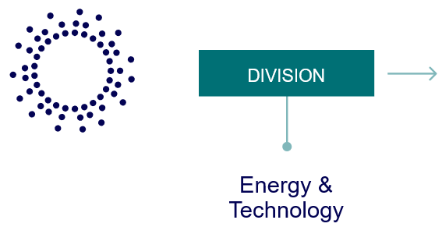
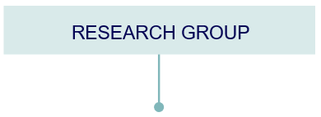
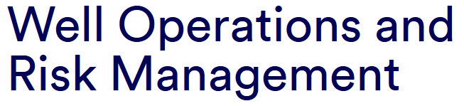
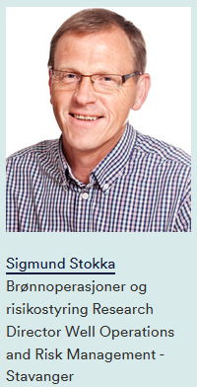
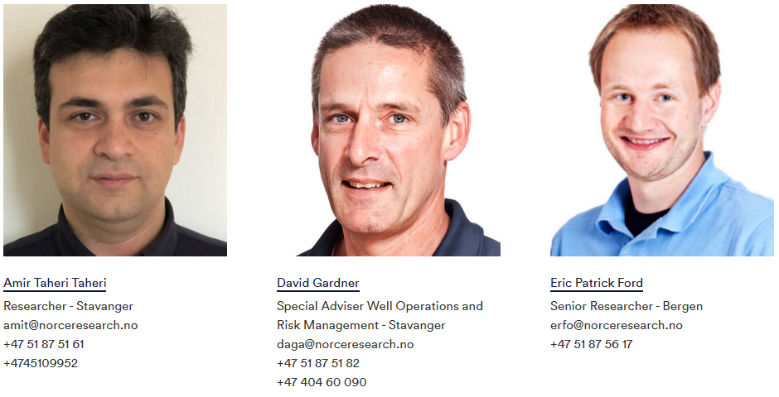

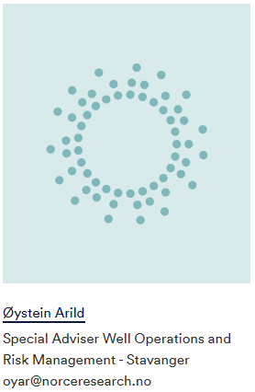
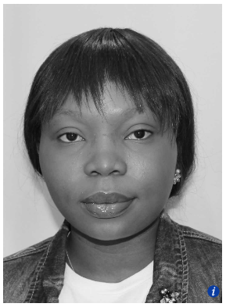
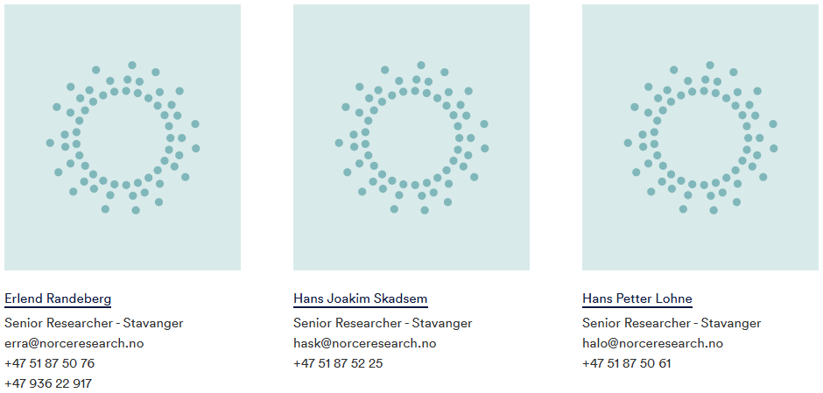
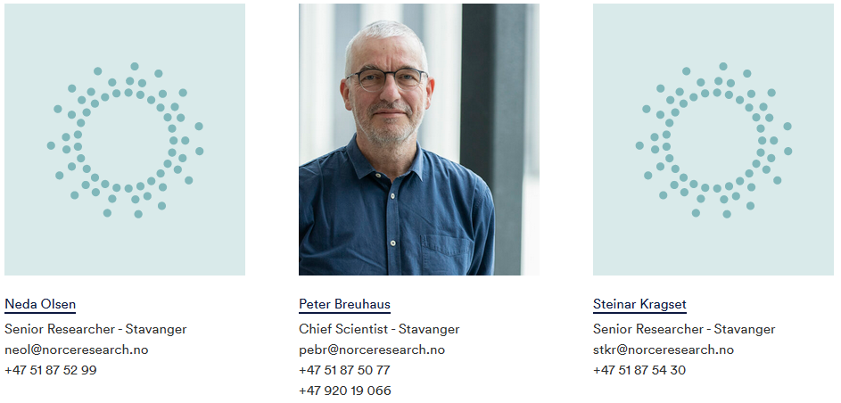
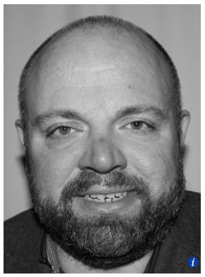
Employees (14)
PhD (2)

Slide 6
Risk and reliability research at NORCE
Division | Group | Field | Topics | Approx. researchers
Energy & Technology | Well operations & risk management | CCS | Storage integrity/Leakage simulation | 4
 |  | Exploration Drilling | Safe operating limits
 |  |  | Blowout analysis
 |  |  | Oil spill preparedness modelling
 |  | Energy vectors/sectors | Risk modelling/security of supply
 |  | Plug & Abandonment | Well barrier integrity/Leakage modelling and experiments
 |  | Geothermal drilling | Risk assessment of geothermal wells
 |  | Well construction | Cost uncertainty assessment
 |  | Value of information | Decision making
 | Earth observation | Avalanche and landslide hazard and risk | Monitoring/Analysis | 3
 | Computational Geosciences and Modelling | CCS | Fault-related leakage risk | 3
 | Sustainable Energy Research Labs | CCS | Well integrity/injectivity | 2
 | Modelling and Simulation | Hydrogen | Risk perception/acceptance | 2
 | Digital Systems | Offshore wind energy | Social acceptance/environmental effects/maintenance optimization | 2
 | Drilling and Well Modeling | Drilling Automation | Real-time drilling safeguards and monitoring | 4
Health & Social Sciences | Climate, environment & sustainability | Avalanche and landslide hazard and risk | Societal risks | 2
 | Work place and innovation | Invisible hazards | Risk perception/acceptance/communication | 4
Climate & Environment | Forecasting Engine | Climate risk | Seasonal forecasting/Disaster risk | 2
 | Gene technology, environment and society | Modern gene technology | Biosafety issues for gene-edited products | 2
 | Earth Systems | Ocean biogeochemistry | Risk assessments of marine ecosystems | 2
3 | 12 | 18 | 20 | 32

Slide 7
Risk & reliability-related publications: 2022
Title | Topics | Group
A Framework to Capture the Relationships in Drilling Data and the Propagation of Uncertainty | Drilling data, uncertainty | Drilling & Well Modeling
Advances in the subseasonal prediction of extreme events: Relevant case studies across the globe | Climate risk | Forecasting Engine
Benefit and risk assessment of fish in the Norwegian diet - Scientific Opinion of the Steering Committee of the Norwegian Scientific Committee for Food and Environment | Biochemistry, contamination | Health & Social Sciences
Exploring the complexity of hydrogen perception and acceptance among key stakeholders in Norway | Hydrogen, risk acceptance | Health & Social Sciences
Oil spill preparedness: Modelling challenges and implications for decision-making | Oil spill preparedness | Risk Management
Evaluation of guidance provided by international standards on metrics and timelines for run-life estimation of oil and gas equipment | Equipment reliability | Risk Management
Risk analysis of unmanned air vehicle and beyond visual line of sight flights : How does systems thinking add to the specific operations risk assessment method? | Operational risk management, aviation | Risk Management
On the new acceptance criteria in NORSOK D-010 for plug and abandonment of wells | Acceptance criteria, P&A | Risk Management
Wellbore stability assessment of an anisotropic shale formation in the North Sea | Well integrity | Risk Management

Slide 8






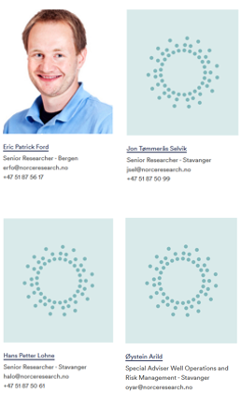





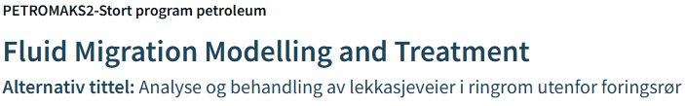

Experience: Projects/topics
Blowout risk
Drilling risks
Leakage risk / storage integrity
RiskVoyance
Oil spill preparedness
Decision analysis
CCS
Drilling & Well construction
CoArc: A transatlantic innovation arena for sustainable development in the Arctic
Well construction cost
Leakage risk / storage integrity
Subsea wells
Equipment reliability
Geothermal wells
Leakage risk / Well barrier integrity
Energy supply security
Plug & Abandonment
Energy sectors

Slide 9
Focus areas 2023
Areas of application:
  Plug & Abandonment (P&A)
  Carbon Capture & Storage (CCS)
  Energy Grids
  Offshore Wind
Focus for risk assessments
  Stochastic/Bayesian methods
  Decision-making contexts
  Comparing risk metrics
  Communicating uncertainty meaningfully

Slide 10
Risk-based approach to Plugged & Abandoned Wells (P&A)
P&A Leakage Calculator: Quantifying quality of cemented well barriers

Slide 11
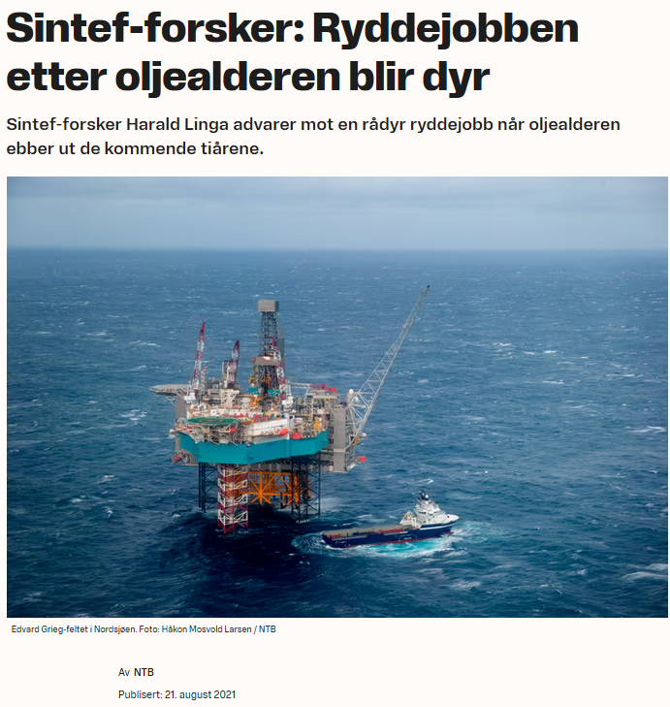
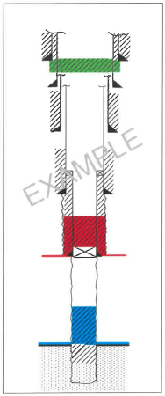
Plugging & Abandonment (P&A)
- Oil & gas wells are required to be plugged and abandoned (P&A) at end of their operative life cycle.
- ~3000 wells on Norwegian Continental Shelf (NCS) need to be P&A’ed in the future.
Estimated cost (per Sintef) ~800 Billion NOK
Required plug length (per NORSOK-D010) 100/50/30 m
Reducing cost: New technology? Changing requirements?
NORSOK D-010:2021
https://e24.no/det-groenne-skiftet/i/ALRK3q/sintef-forsker-ryddejobben-etter-oljealderen-blir-dyr

Slide 12








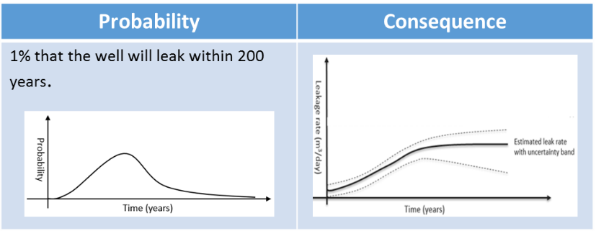
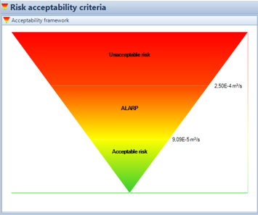

P&A Leakage Calculator: A Risk-based approach to P&A
Design quality assessment
Compliance with NORSOK D-010?
Well under consideration for PP&A
Propose permanent barrier design
Final barrier system (A)
Acceptable risk?
Quality evaluation, expressed in terms of leakage risk
Decision support for P&A design
Cost/benefit of alternative P&A designs
Establishing risk acceptability criteria
«Risking» of well barriers
Estimation of expected barrier lifetime
Environmental impact of various seepage scenarios
Conformity to prevailing standards/guidelines?
Sensitivity of P&A design vs. Well integrity

Slide 13
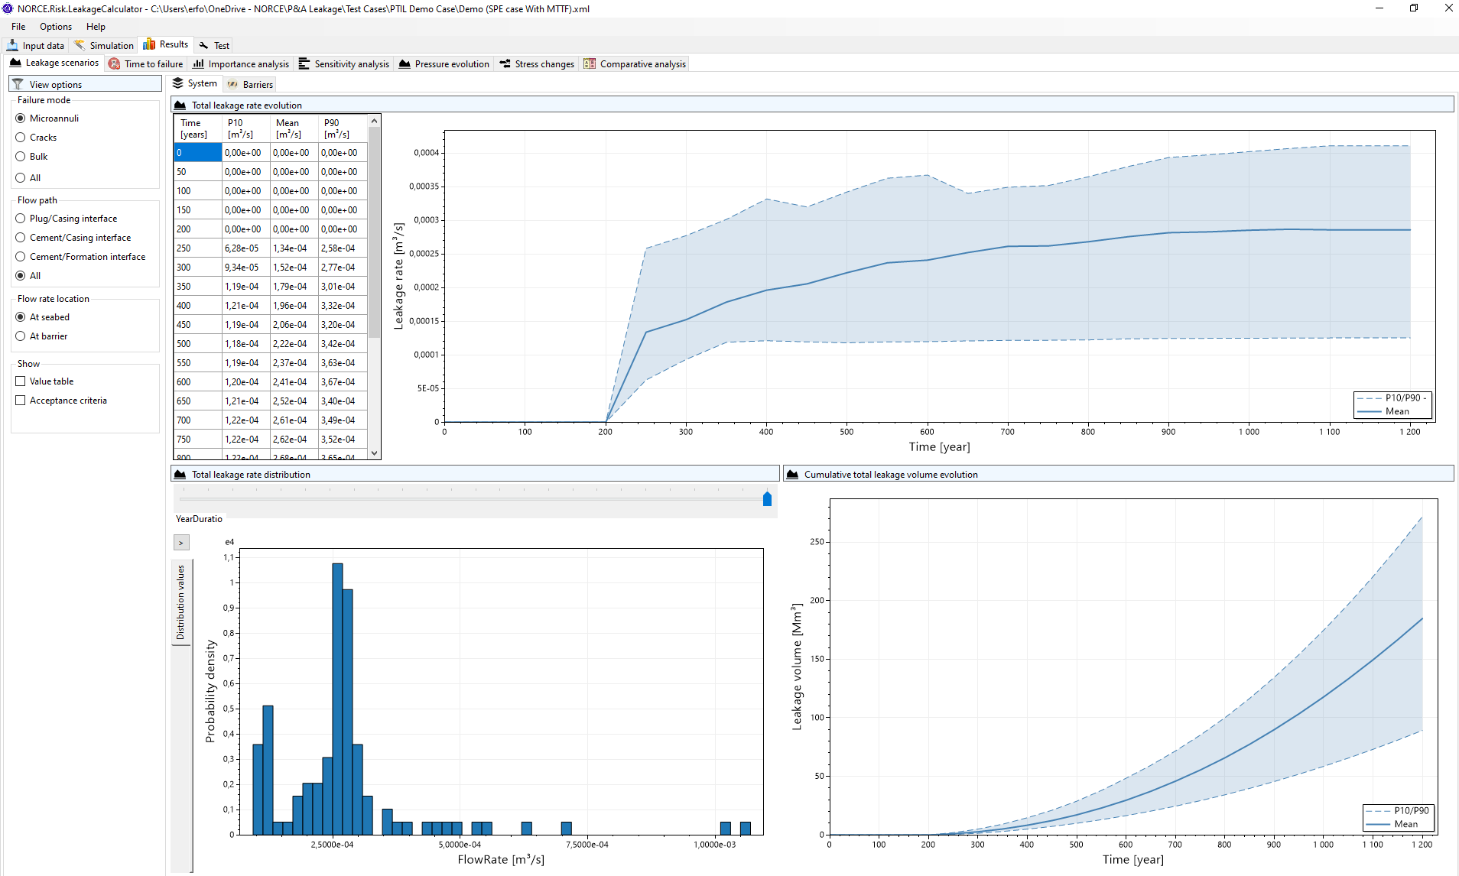
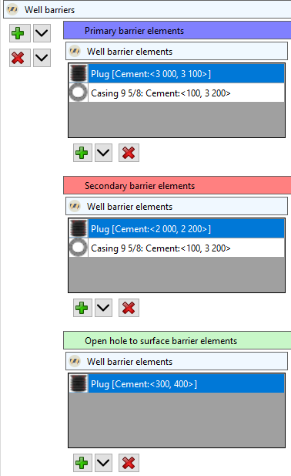
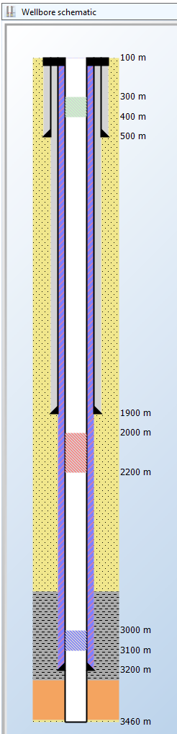

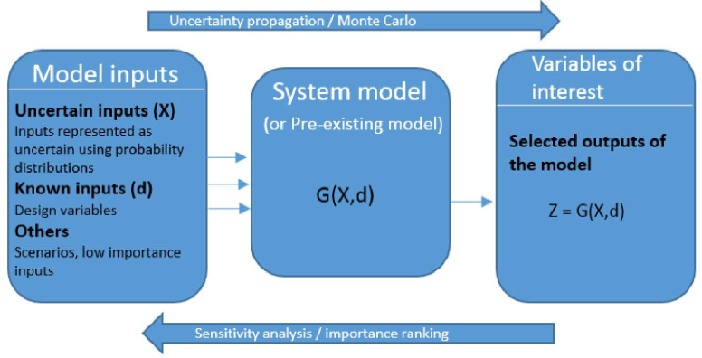
P&A Leakage Calculator - Overview
Stochastic/deterministic
Total leakage rate over time
Total leakage rate per well barrier
Failure probability per barrier
Importance analysis per barrier/failure mode
Sensitivity analysis for plug length/location
Comparative analysis for alternative P&A designs
INPUT DATA
Well information
Geological information
Reservoir properties
Proposed well design
Proposed P&A design
Plug material mechanical properties
Well barrier envelopes
Failure mode properties
Lifetime data
Acceptability criteria
RESULTS
MODELS
PVT model
Material Balance model
Stress model
Failure Mode model
Microannuli models
Leakage Rate model
Time-To-Failure model
Monte Carlo Simulation framework

Slide 14









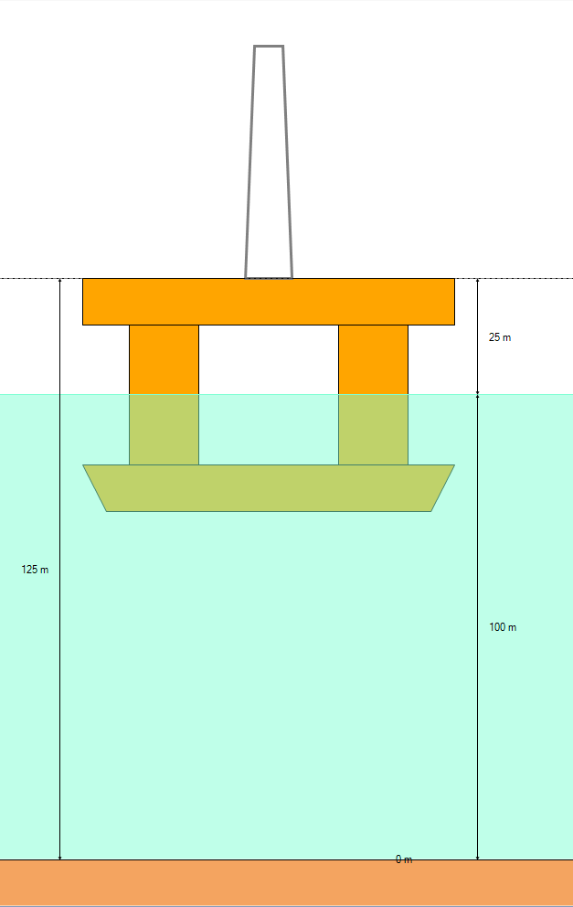


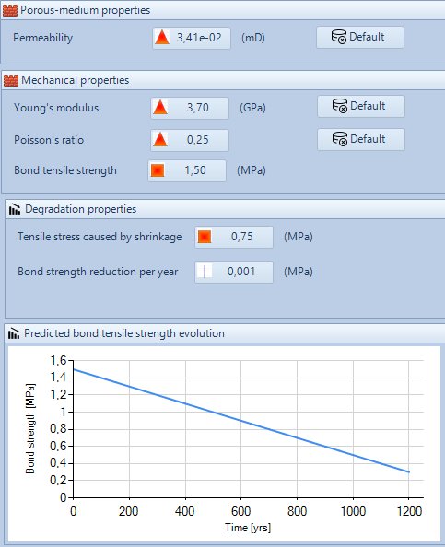



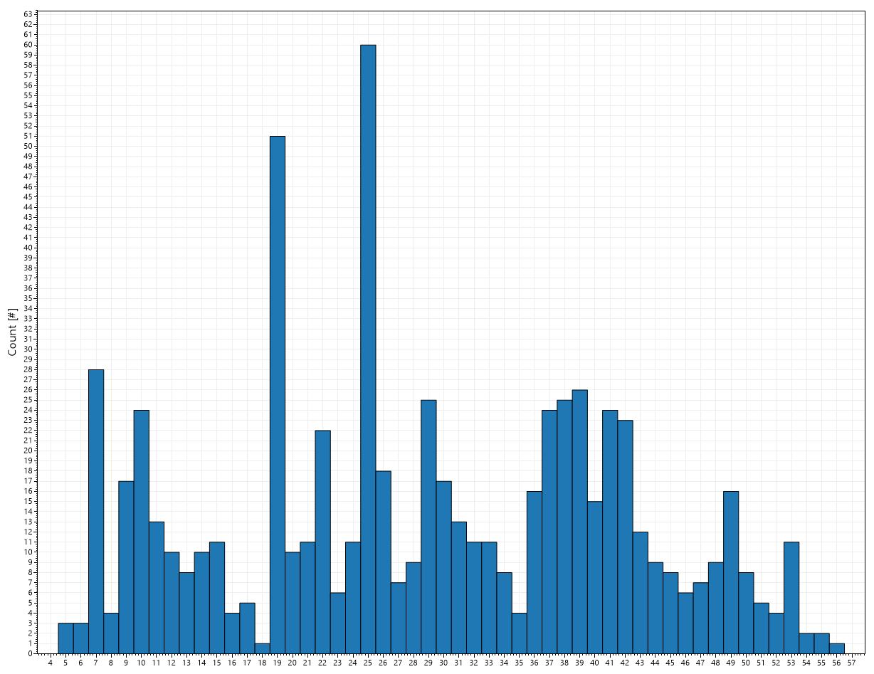
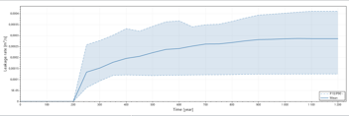


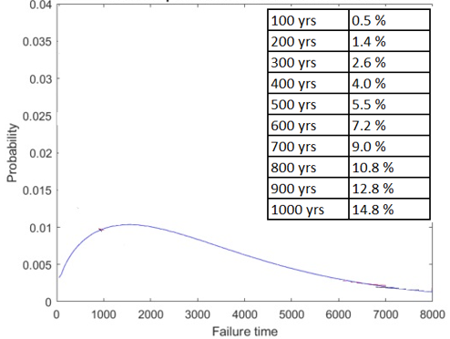
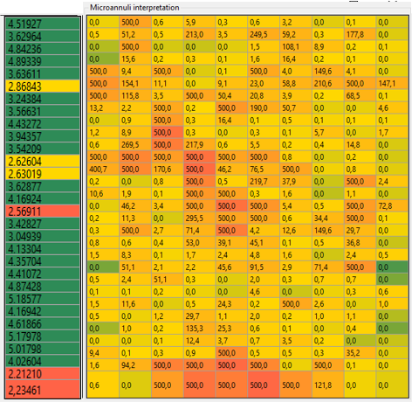
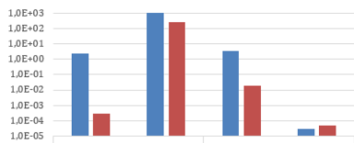

P&A Leakage Calculator: Input overview
How is well designed?
What are the well barriers?
How can barriers fail?
Consequence?
CATEGORY
Name
Location
Operator
Offshore?
Depth
Rock type
Reservoir?
(Fluid properties)
(Pressure evolution)
Depths
Dimensions
Cemented segments
Depth
Length
Material
Permeability
Mechanical
properties
Degradation
Type
WBE’s
Possible failures
Crack size
Microannuli model
Log data
Screening:
similarity to historical data
Leakage rate evolution
MTTF
Sensitivity
Comparative analysis
INPUT DATA

Slide 15
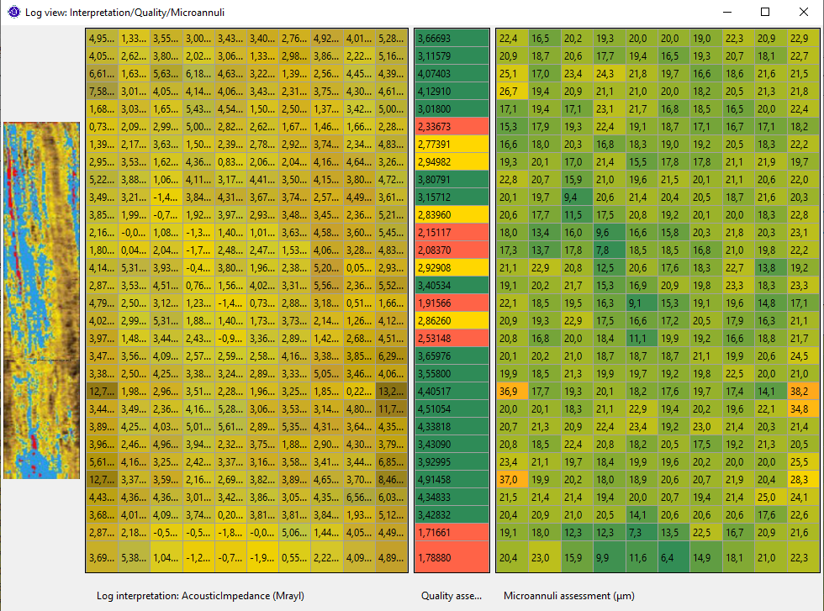
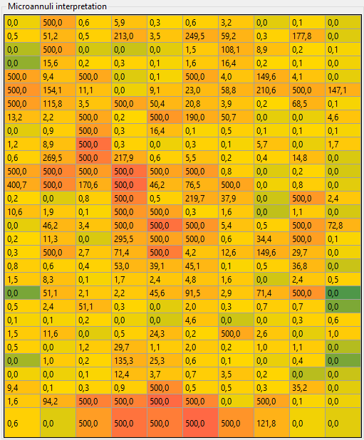
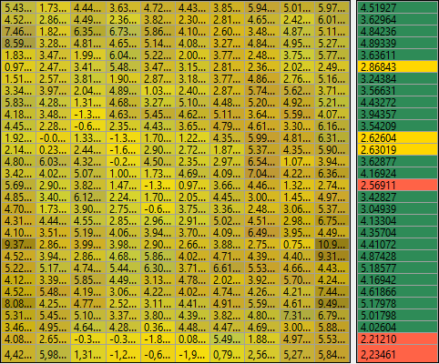
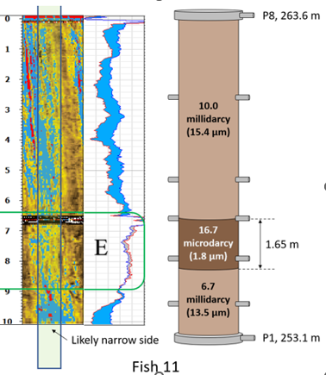

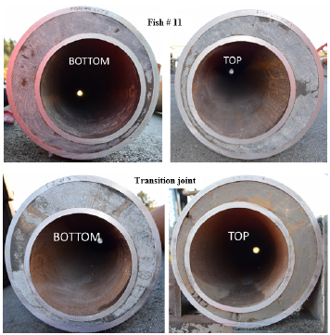
Challenge: Convert information to risk-related metrics
Cement-bond log:
Acoustic impedance
Model representation
Microannuli
(risk-related metric)
Barrier quality

Slide 16
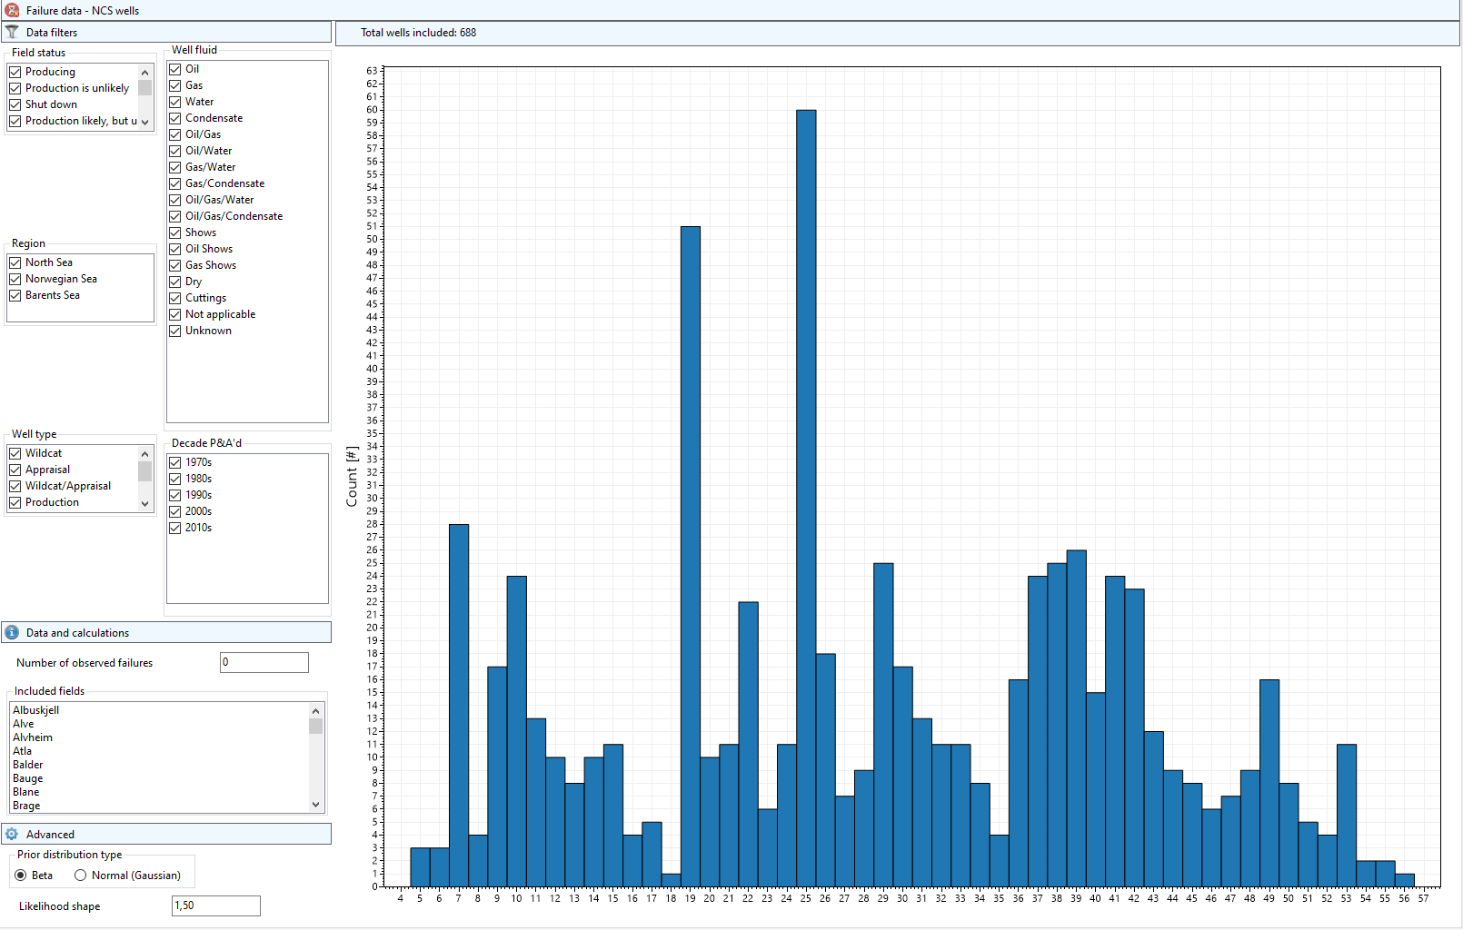


Challenge: Evaluation of «barrier performance» – NCS well data
NCS data set, 688 wells
No exclusions made from this data set
Number observed failures = 0
Data collected from the publicly available webpages of the Norwegian Petroleum Directorate
Framework: Bayesian approach
Combines relevant data, in this case survival data, and a physical model for how failure occurs
Need to make an assumption on the probability distribution that explains time-to-failure; in this case we have selected a Weibull distribution
In a Bayesian setup, the physical model is assigned as «prior information», while the survival data are «data»
Parameter updates are conducted by using Bayes formula

Slide 17
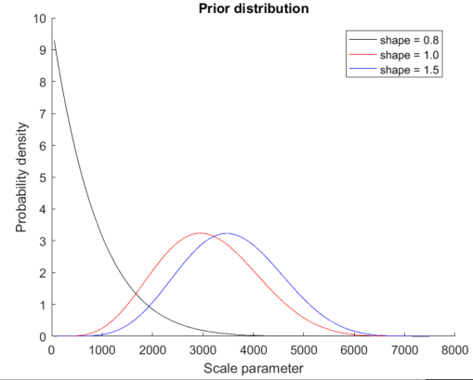
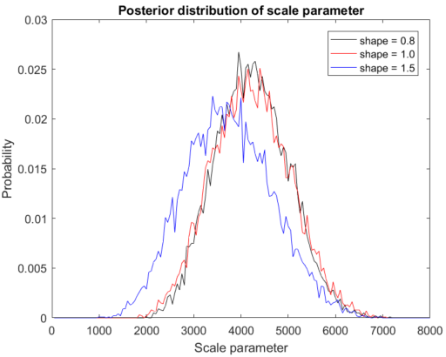

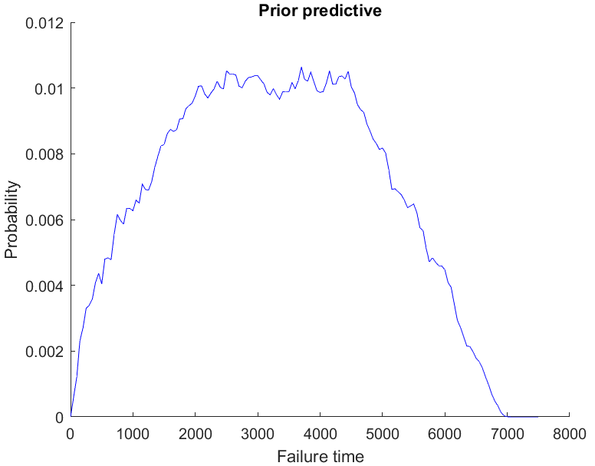
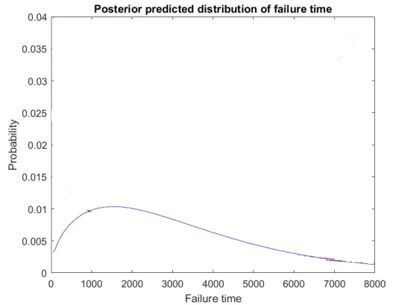
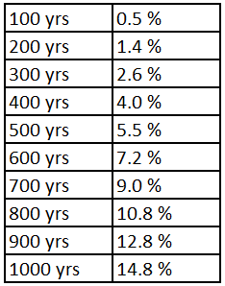
Bayesian methodology
Shape of failure rate (increasing,constant, decreasing)
Prior distribution
Inversion using Monte Carlo trial-and-error
Bayes formula
Physical model for microannuli
Lifetime distribution for P&A’ed wells on the NCS

Slide 18
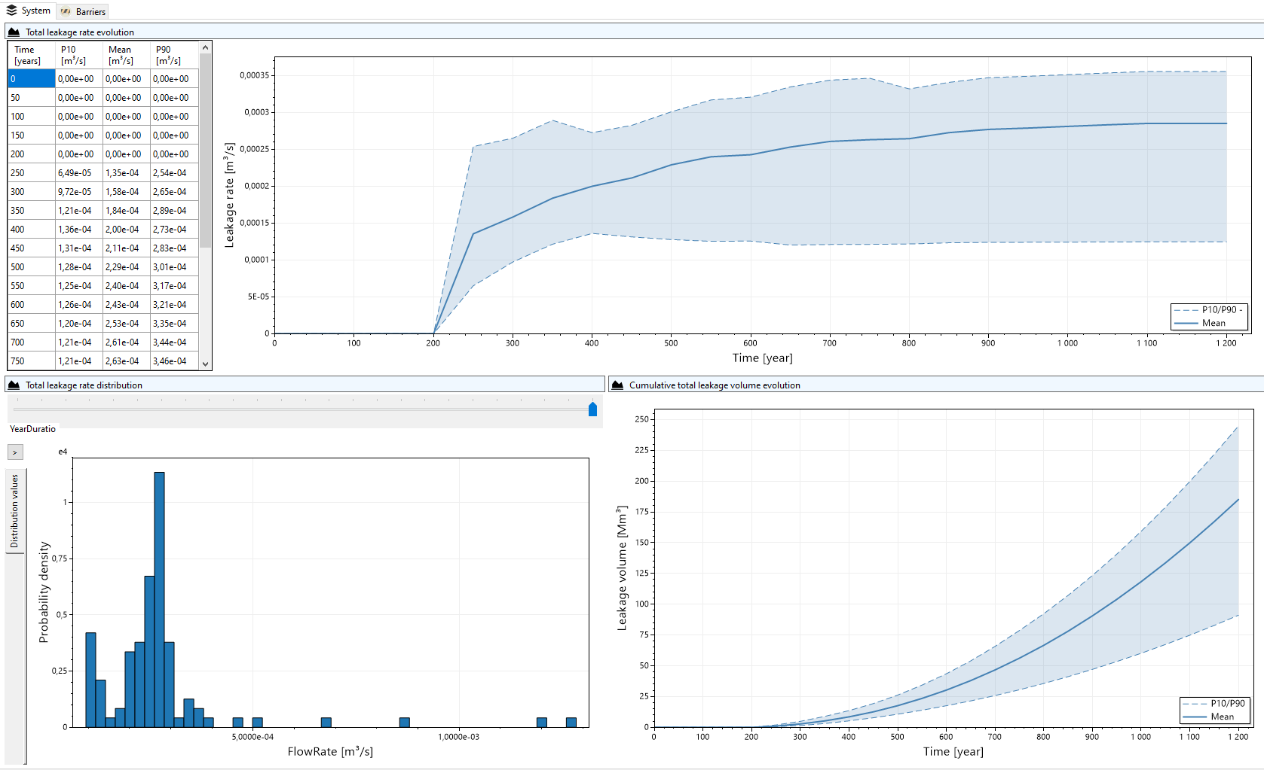
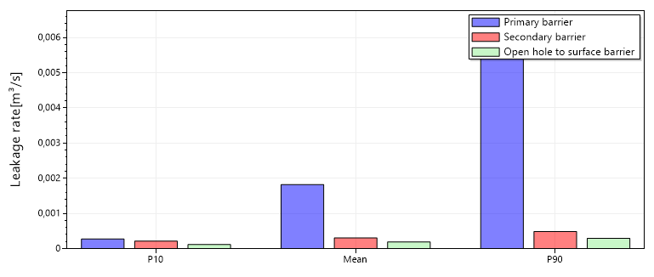
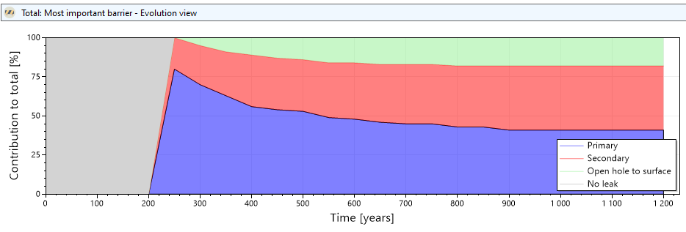
Leakage rate results
System or barrier level leakage rate over time
Estimated released volumes
Importance and relative comparison of barriers
Is risk acceptable?
How can risk be reduced ALARP?

Slide 19
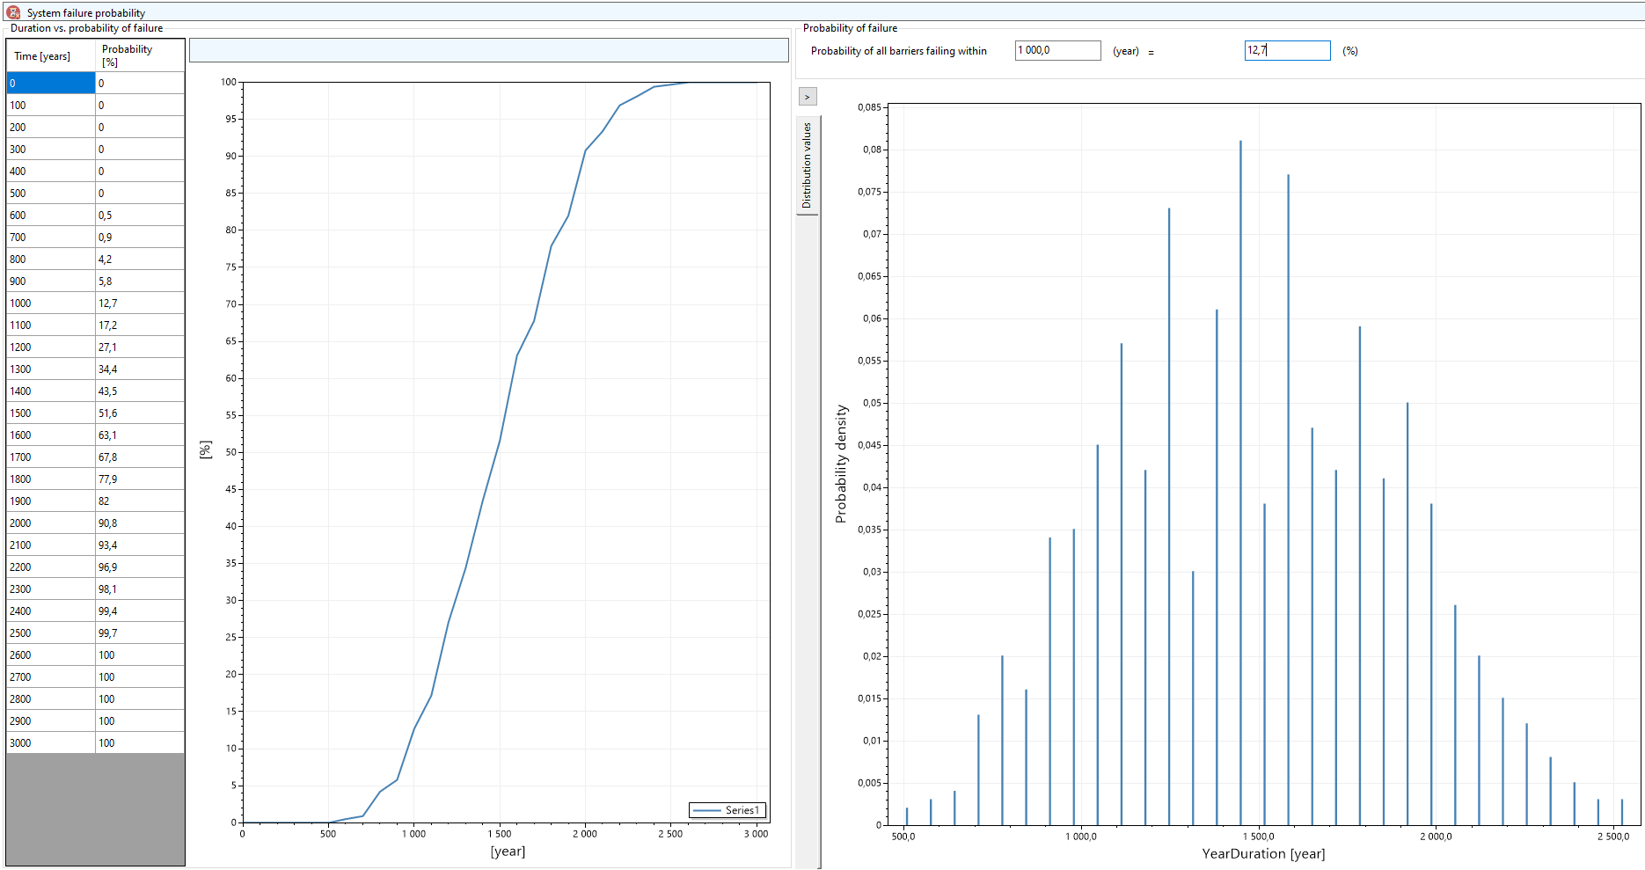
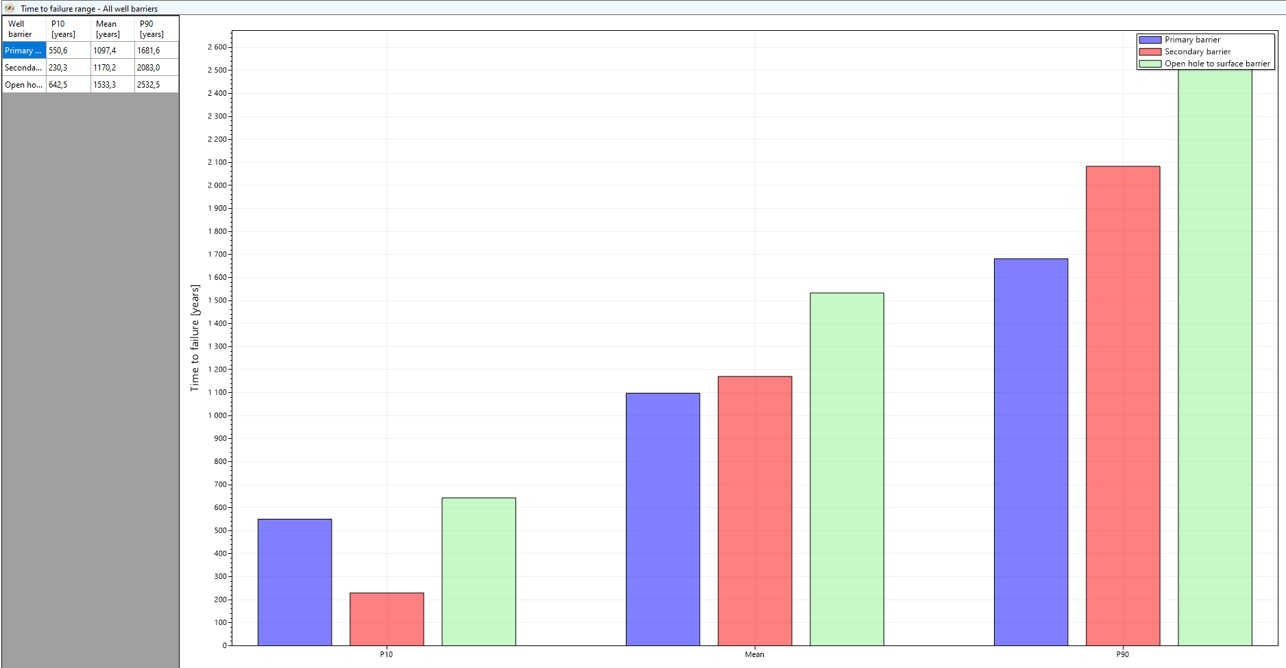
Probability of failure results
System or barrier level Mean-time-to-failure
Importance and relative comparison of barriers
Is risk acceptable?
How can risk be reduced ALARP?

Slide 20
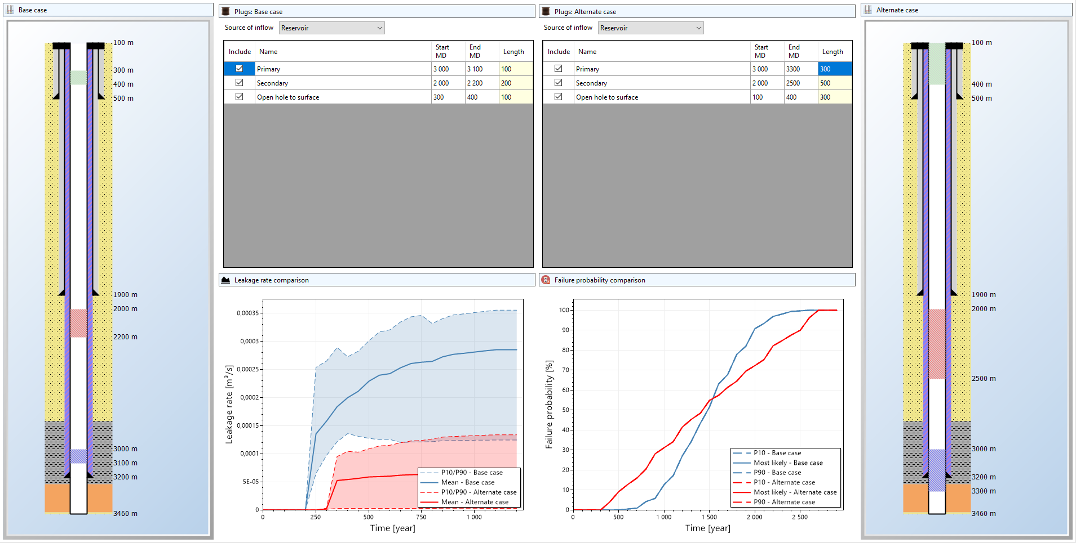
Using results to compare P&A designs
The framework allows for comparing the quality of alternate P&A designs, using potential leakage rate or expected time to failure
Differences could depend on e.g.
  Barrier material
  Barrier location
  Barrier length
  Failure assumptions
  +++
Base case
Alternate case
Accept existing P&A design or modify?

Slide 21
CO2-SPICER
CO2 Storage Pilot in a Carbonate Reservoir

Slide 22

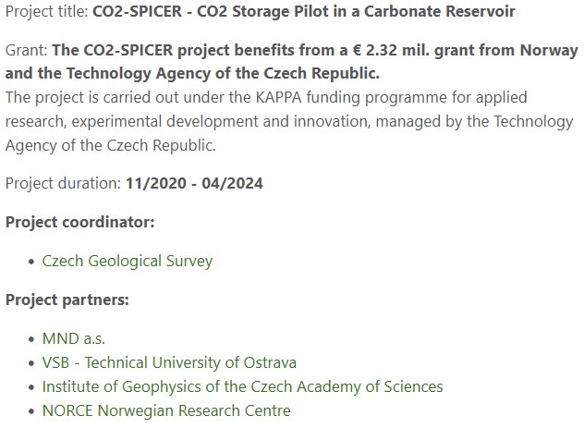
https://co2-spicer.geology.cz/en

Slide 23
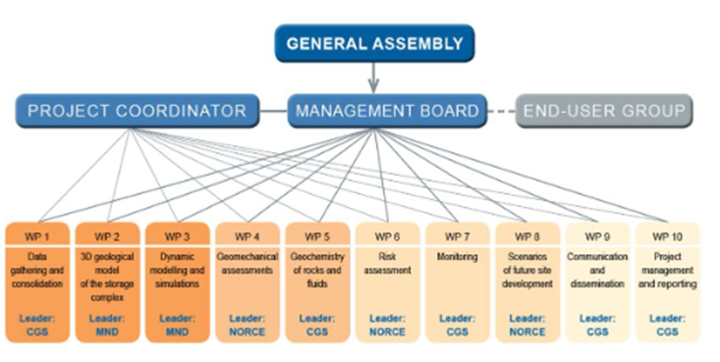
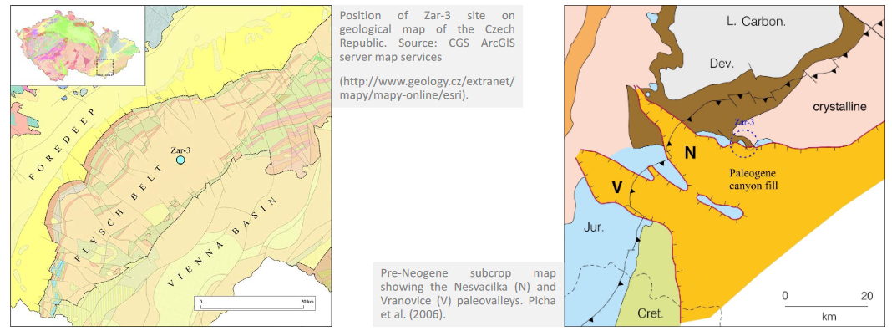
CO2-SPICER: Project
Main project objective is to prepare implementation of a CO2 geological storage pilot project at the mature Zar-3 oil and gas field in the Czech Republic (achieve implementation-ready stage)
Main identified leakage risk is from abandoned wellbores
How would leakage of natural gas or CO2 disperse and impact on surroundings?
https://co2-spicer.geology.cz/sites/default/files/2023-01/Hladik-CO2-SPICER-GHGT-16_22-10-20_0.pdf

Slide 24

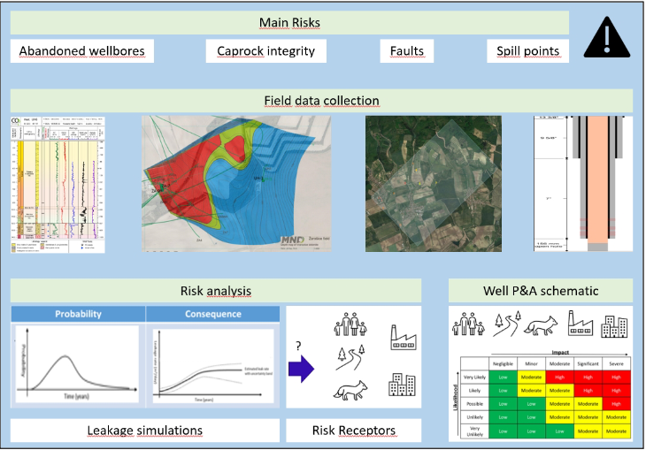
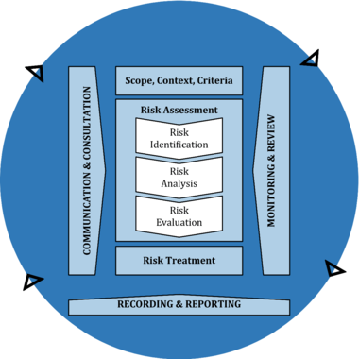
CO2-SPICER: Risk analysis
Collected data will be used to simulate leakage through abandoned wellbores, caprock, faults and spill points, next step will address the risk to various receptors
: WP6 Risk analysis
ISO31000:2018
https://co2-spicer.geology.cz/sites/default/files/2023-01/Hladik-CO2-SPICER-GHGT-16_22-10-20_0.pdf

Slide 25
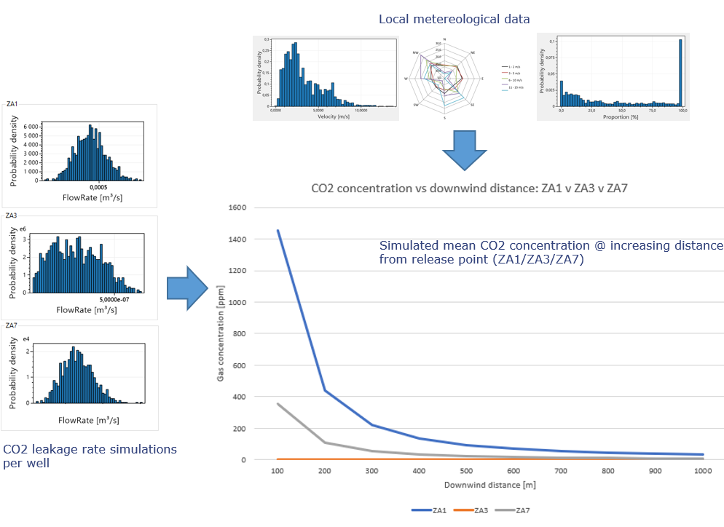


CO2-SPICER: Site storage integrity
Determining most likely point of leakage and possible magnitude, as a basis for estimating possible concentrations of released gas
https://co2-spicer.geology.cz/sites/default/files/2023-01/Hladik-CO2-SPICER-GHGT-16_22-10-20_0.pdf

Slide 26







CO2-SPICER: Release scenarios
Release scenarios can in turn be used as a basis for determining possible consequences for risk receptors, and as a basis for evaluating acceptable risk.
https://co2-spicer.geology.cz/sites/default/files/2023-01/Hladik-CO2-SPICER-GHGT-16_22-10-20_0.pdf

Slide 27
ELEXIA
Reliability of energy supply across sectors and vectors

Slide 28







ELEXIA T2.3.4: High-level concept
Real world: Interactions between energy system components
Simulation results:
Decision support
Contingency measures
Maintenance planning
Optimization
Decisions/Changes
Model representation: Energy supply reliability
Model implementation: Software for scenario simulations

Slide 29


Model utilization
Decision making:
Measures to reduce system/component failure probability?
Measures to increase redundancy?
Measures to optimize maintenance strategy?
Measures to detect failures?
Measures to increase resilience/flexibility?
Measure to improve outage restoration?
Measures to reduced uncertainty?
Security of supply prototype software
Simulation results
Which failures are most critical?
Failure impact on energy supply
Varying conditions impact on energy supply
What is expected time to detect and repair failures?
System vulnerabilities
Operation optimization potential
Maintenance optimization potential
Proposed changes

Slide 30
Eric Ford
erfo@norceresearch.no
norceresearch.no

